Slide 1

Intro to CUmulus: a free Research Cloud platform for RMACC

Slide 2
Intro to CUmulus
Andrew Wilson (CU Boulder Research Computing User Support)
www.rc.colorado.edu
rc-help@colorado.edu

Slide 3
Outline
CU Boulder Research Computing Overview
What is CUmulus?
What resources are available?
Who can use CUmulus?
Example use cases
How to access CUmulus

Slide 4
CU Research Computing Overview
Provides Computing and Data Storage Beyond standard desktop resources:
High Performance Computing (HCP), clusters include:
Alpine
Blanca
Storage of Research Data
PetaLibrary
High-Speed Data Transfer
Globus Endpoint
Cloud Resources
CUmulus (On-premise Cloud)
Cloud Foundations (Commercial Cloud)
Secure Cloud Resources
Consulting in Computational Science and Data Management

Slide 5
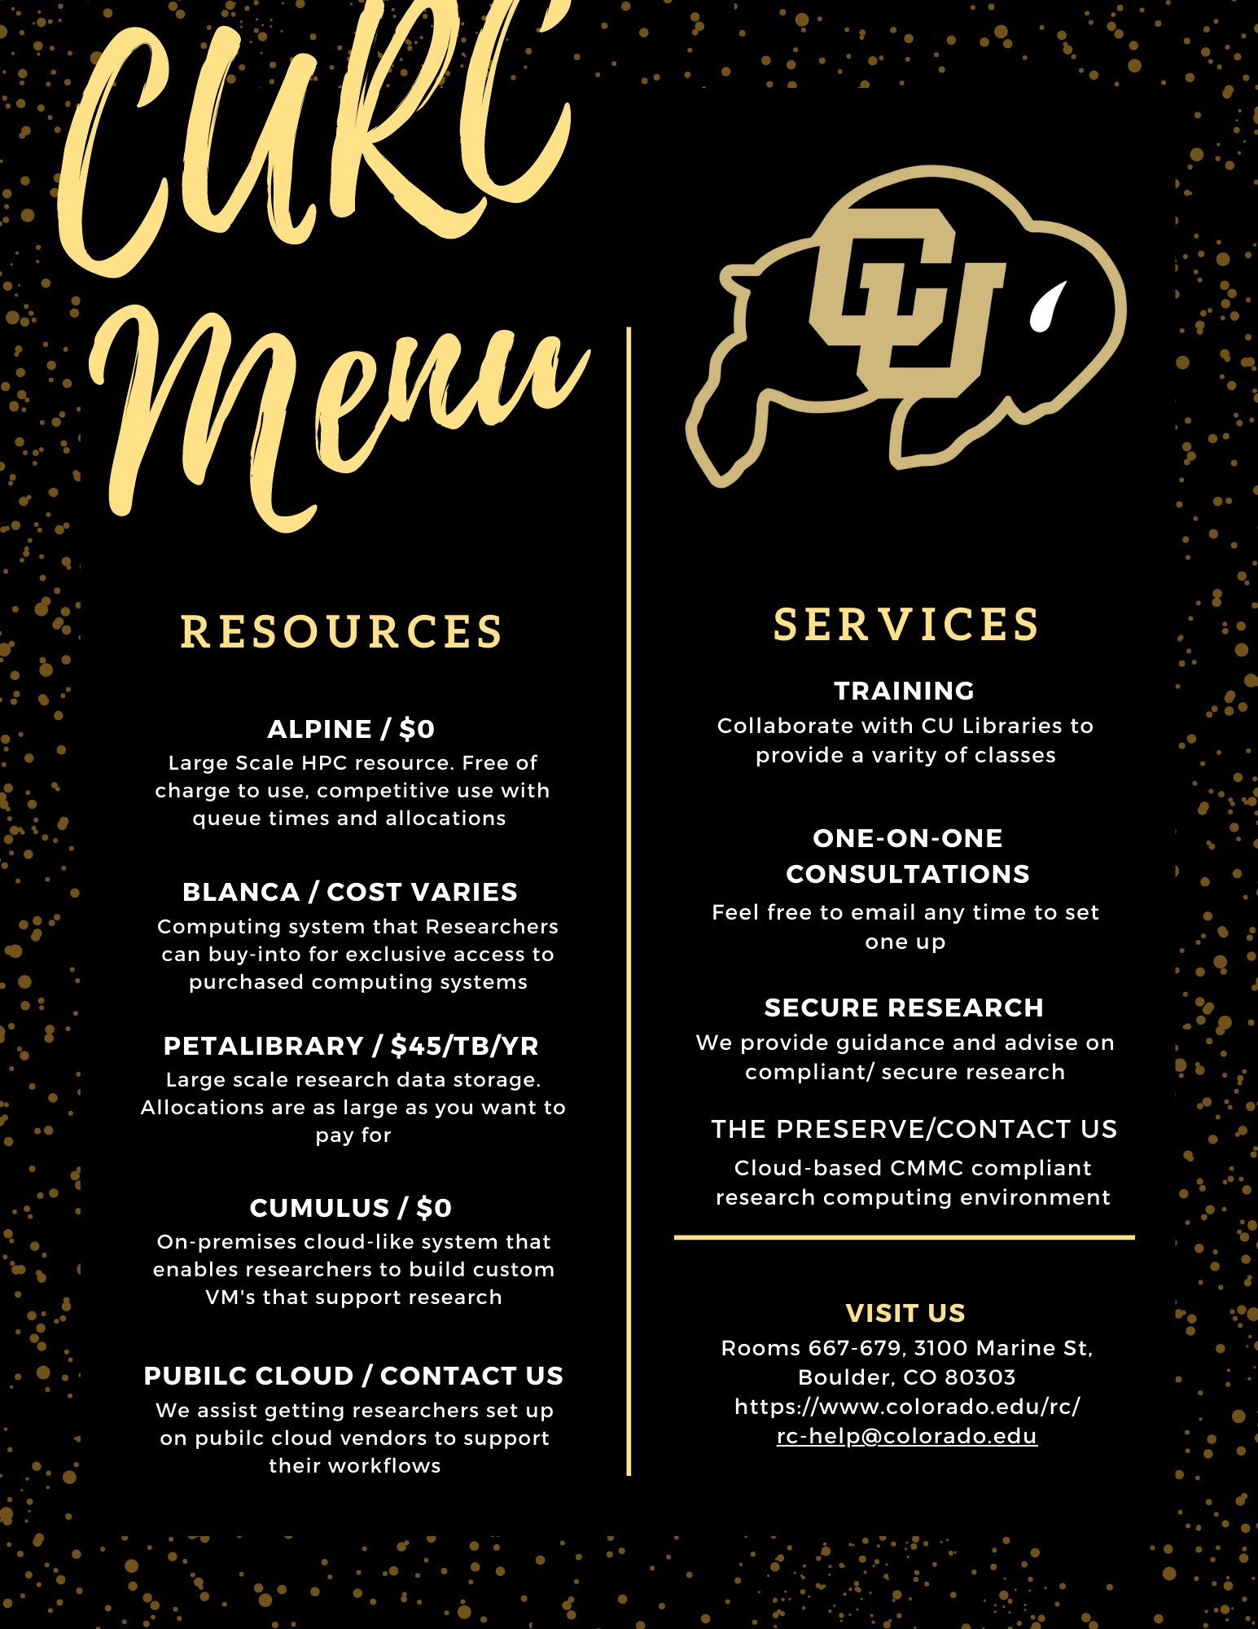
CU Research Computing Overview

Slide 6
What is CUmulus?
CUmulus is CU Research Computing's free-to-use on-premise cloud service
Supports cases not well-suited for HPC such as:
Research-Oriented Web Servers
Databases
Long-Running Services
Research Hubs (Jupyterhub, RStudio Server, etc)
Provides users with persistent or ongoing availability by allocating logically isolated section of the cloud

Slide 7
What is CUmulus?
You get your own virtual environment for experimentation - an environment that can be easily created/tested/removed
Install Software
Administer your instance (you’re in control!)
Run applications and jobs
Interface w/ other CURC services: Blanca, Alpine, PetaLibrary
You can request specific resources (CPU, storage, memory) and can set up persistent storage

Slide 8
What resources do we have available?
Intel Hardware
264 Physical Cores, 528 with Hyper Threading
4GB RAM per core
101.3 TiB of Object-Oriented Storage (SSD)

Slide 9
Example Use Case: Persistent Data Mining
Researcher wanted to use online text database to train novel search algorithm
Needs:
Persistent Querying of an online text database
Persistent storage of data
Compute ability to continuously mine the data and advance their algorithm
They were able to:
Setup a data stream that queries data from Reddit at specified times of the day
Have the resources for persistent storage of large datasets and compute resources
Test and develop their novel search mechanism
9

Slide 10
Example Use Case: Open Access Research Tool
Researcher wanted to publish and host trainings for a custom language processing tool that helps to build language databases and tools (think auto-correct) for endangered languages
Needs:
A web-based dashboard where any user can load and use the tools the research team developed
Persistent storage of data
Compute ability to continuously mine the data and advance algorithm
They were able to:
Setup a Jupyterhub instance where they control access of users
Have an environment where researchers around the world can easily use their research tools
Collect the incoming test data and use that for future training
Have the resources for persistent storage of large datasets and compute resources
10

Slide 11
Example Use Case: Galaxy Server
Researcher wanted to create a custom Galaxy Server (web-based GUI for popular bioinformatics software)
Needs:
A way to host a website that the researchers can use to load and analyze data, create reports and schedule compute jobs
Persistent storage of data
The ability to create compute jobs on the virtual machine or send jobs to the Alpine Supercomputer
Run persistent jobs (multiple days long)
They were able to:
Host the website, and control access of users who can access it
Have the resources for persistent storage of large datasets and compute resources
Create an interface to send jobs to the Alpine Supercomputer, all controlled via GUI
Test custom tools and data pipelines that they created
11

Slide 12
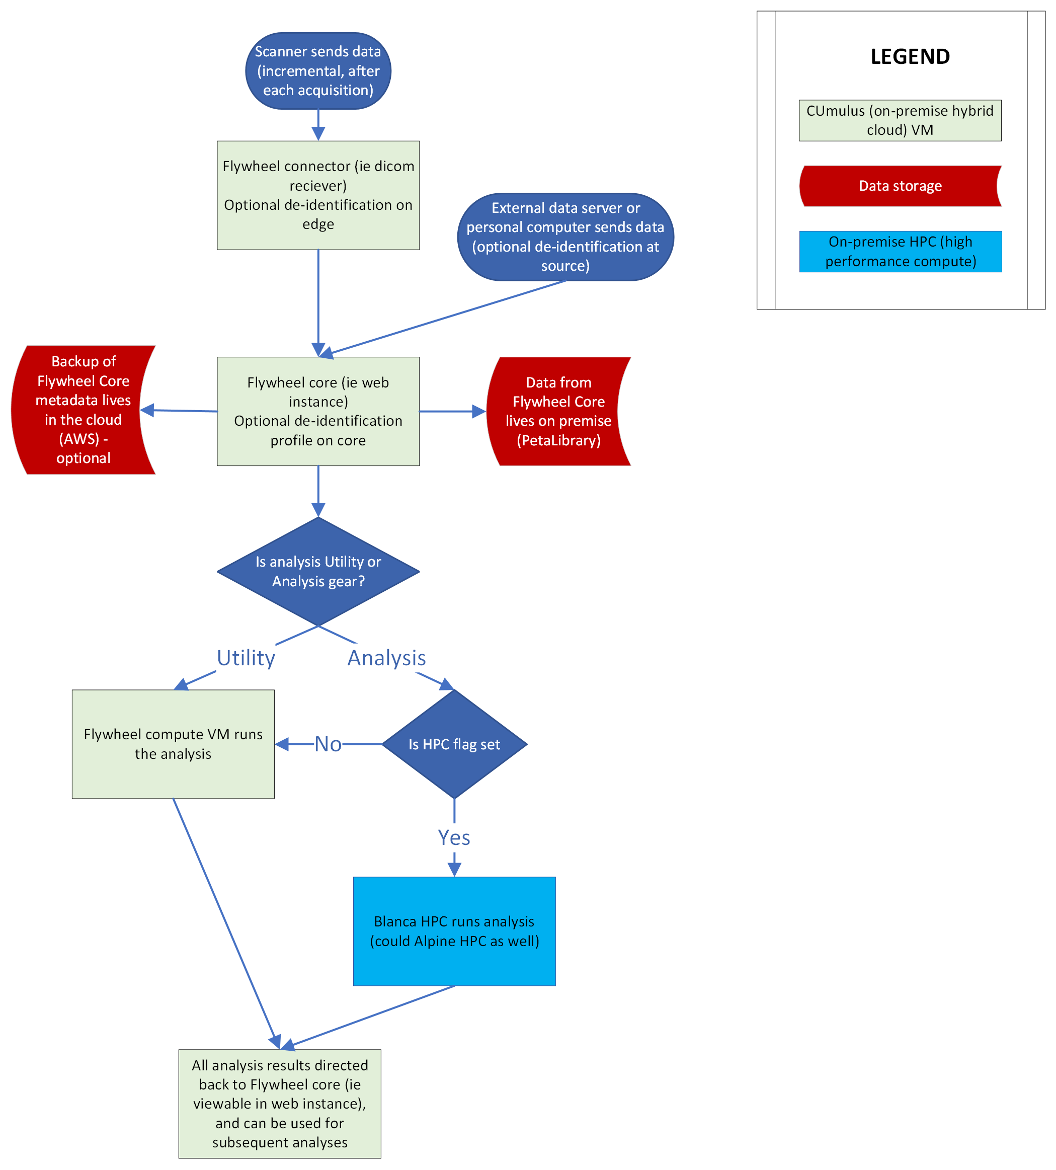
Example Use Case: Flywheel Project
Researcher wanted to create a tool that interfaces with MRI machines in the area and pulls data to a persistent web application where they can create processing pipelines and send these to the Alpine Supercomputer
Needs:
A web-based dashboard where users can develop processing pipelines, move data, and create compute jobs
Persistent storage of data (very large datasets)
Compute ability to continuously process the data
They were able to:
Setup a Flywheel Dashboard, a web-based application that researchers can access from anywhere.
Store data on the VM or in PetaLibrary or AWS
Send jobs to the Alpine Supercomputer for faster processing
12

Slide 13
CUmulus Access

Slide 14
CUmulus Access and Allocation
Submit a proposal for your use case (email rc-help@colorado.edu)
Describe your CUmulus workflow
Describe why your workflow is appropriate for CUmulus
Estimate the resources you require:
Operating System, CPU cores, Disk Space, Memory
This is an iterative process where we work with you to make sure the request for resources fits your (and our) needs
Learn more about the allocation request process at https://www.colorado.edu/rc/userservices/allocations

Slide 15
Access to CUmulus Resources
There are 3 current authentication/login methods at cumulus.rc.colorado.edu/:
CU Boulder
CSU Fort Collins
XSEDE* (all other RMACC institutions)
Create account: https://portal.xsede.org/#/guest
Configure 2FA (Duo): https://portal.xsede.org/mfa

Slide 16
How to get access
Request a CUmulus application by contacting the CU RC help-desk: rc-help@colorado.edu
Once your application has been accepted, manage your project at the CUmulus Web Portal.
Check out our documentation on example use cases and how to setup your instance
Visit all our CUmulus specific tutorials on the Research Computing GitHub for step-by-step examples.

Slide 17
A few questions for you:
What types of applications could you see your users building on CUmulus?
What demand do you have for these types of persistent services?

Slide 18
Thank you!
Contact: anwi7603@colorado.edu
Help Desk: rc-help@colorado.edu
Hands-on with CUmulus: a free Research Cloud platform for RMACC
90-minute session where we can all create an account and get hands-on with CUmulus
Wednesday, May 17, 1pm-2:30pm

